Slide 1
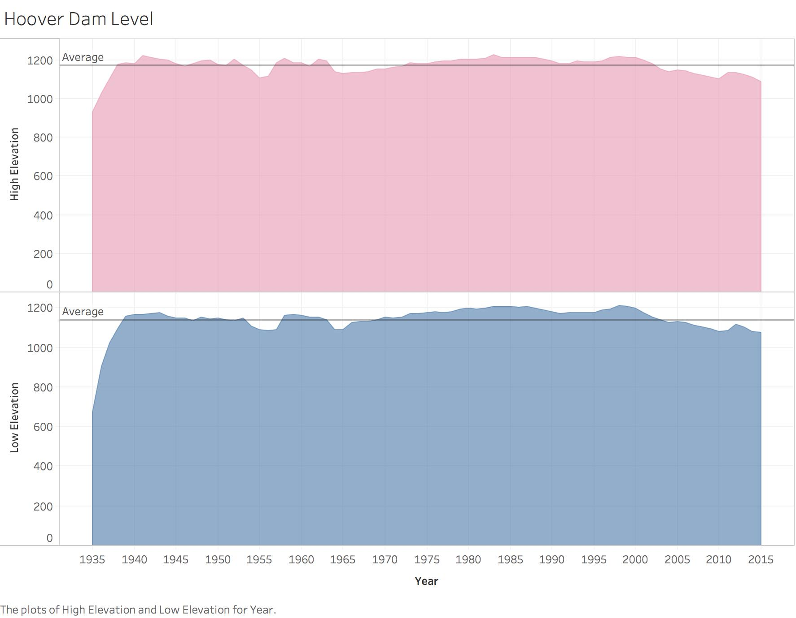

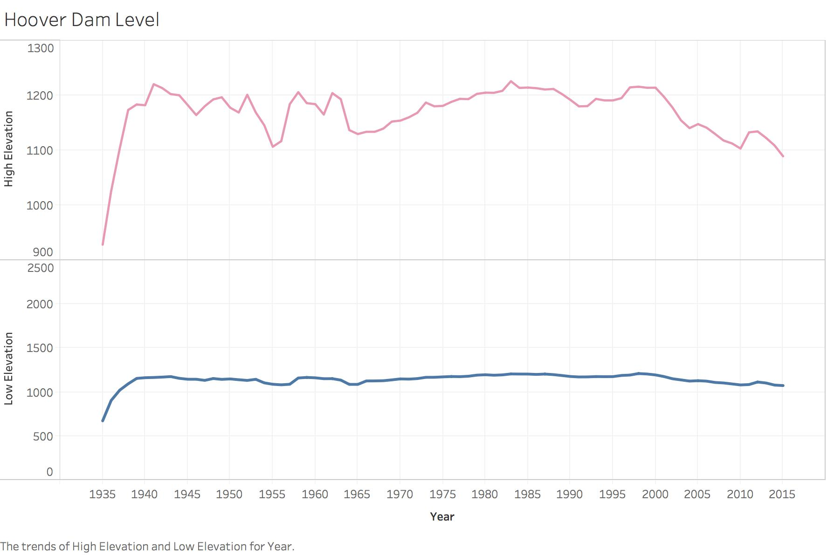
“Truth”
“Lake Mead and Colorado River Watermaster Hydrographic Daily Log” Excel data file :
Two measures of water level, 1935 – 2015
For the “Lie”: Many people may quickly reach to a conclusion that the fluctuation and volatility level of High Elevation during this time period is more drastic than Low Elevation.
For the “Truth” : When the range and unit interval gap for Low and High Elevation in the y-axis are same, the fluctuation High Elevation is not as drastic or violent as the “lies” graph on the left.
“Lie”
 | Low Elevation | High Elevation
Maximum | 1211.37 | 1225.85
Minimum | 673.5 | 928.45
Annual Average | 1141.052593 | 1169.127901
Standard Deviation | 71.19125309 | 46.40836309
Actually, Low Elevation is more unstable compared to High Elevation, with higher standard deviation.

